Slide 1

Customer Shopping
Behavior Analysis
Analyzing 3,900 customer purchases to map spending habits, product preferences, and subscription engagement for strategic business planning.

Slide 2

Dataset Overview
3,900
18
50
Customer Purchases
Data Columns
Locations
Transactional records analyzed
Features tracked per transaction
Geographic coverage
25
Product Types
Items in catalog
Demographics
Purchase Details
Age, Gender, Location
Item, Category, Amount
Subscription Status
Season, Size, Color

Slide 3
Data Preparation Process
01
02
03
Data Loading
Initial Exploration
Missing Data Handling
Imported dataset using pandas
Structure check and summary statistics
Imputed 37 missing Review Ratings with median values
04
05
Feature Engineering
Database Integration
Created age_group and purchase_frequency_days columns
Loaded cleaned data into PostgreSQL

Slide 4

Key Statistical Insights
Average Purchase
Customer Age
$59.76
44 years
Mean transaction value
Average customer age
Review Rating
Previous Purchases
3.75 / 5.0
25 average
Average product rating
Customer purchase history
Gender Split
Top Category
Subscription Rate
Male: 68%
Clothing: 45%
27% subscribed
Female: 32%
Most purchased
73% non-subscribers

Slide 5
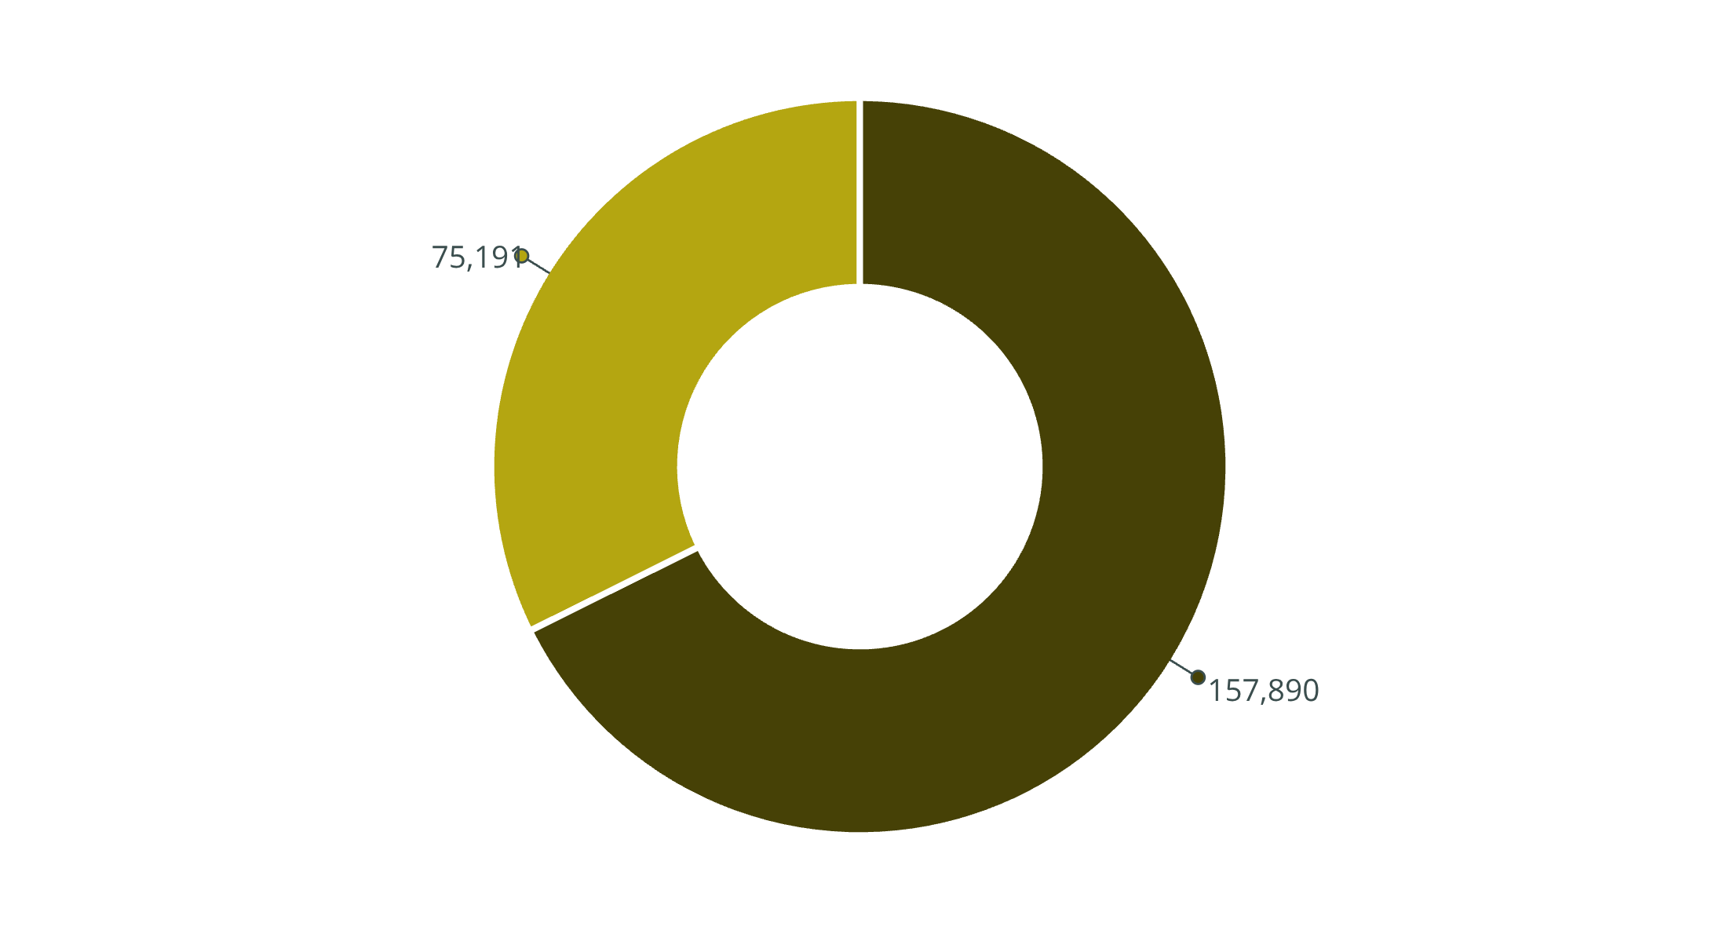
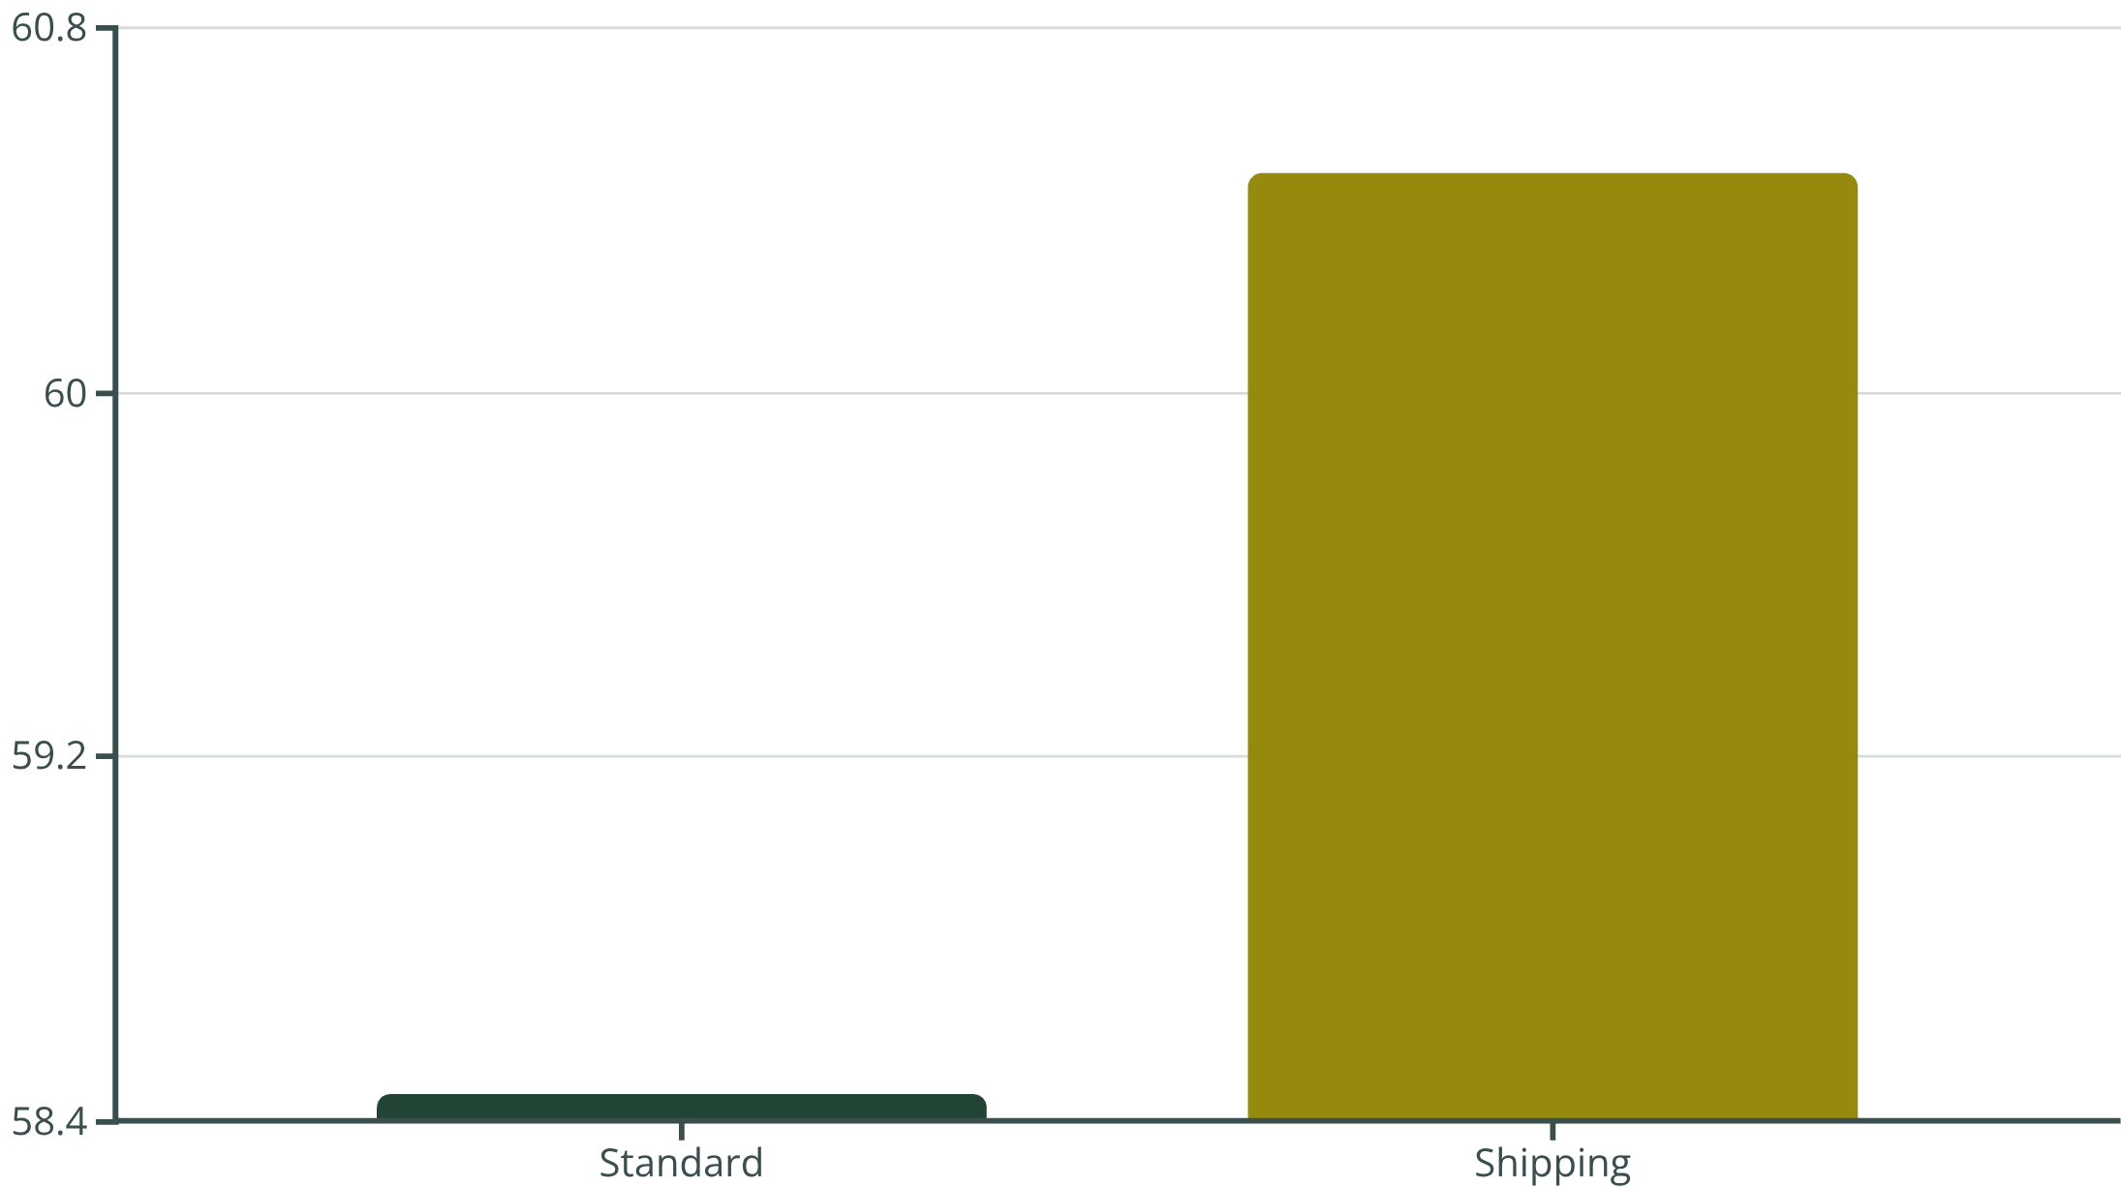
Revenue & Spending Analysis
Revenue by Gender
Shipping Preferences
Males generate higher total revenue due to larger customer base
Express: $60.48 avg
Standard: $58.46 avg
Male
Female
High-spending discount users identified: customers using discounts while spending above average

Slide 6
Product Performance
1
2
3
Gloves
Sandals
Boots
Rating: 3.86
Rating: 3.84
Rating: 3.82
4
5
Hat
Skirt
Rating: 3.80
Rating: 3.78
Discount-Dependent Products
Hat
Sneakers
Coat
Sweater
50% discount rate
49% discount rate
49% discount rate
48% discount rate
Pants
47% discount rate

Slide 7






Customer Segmentation
New
1
83 customers
2
Returning
701 customers
3
Loyal
3,116 customers
Customer classification based on purchase history reveals strong loyalty base
80%
18%
2%
Loyal Customers
Returning Buyers
New Customers
Majority segment driving revenue
Growth opportunity segment
Acquisition focus needed

Slide 8
Subscription Impact
Subscribers
Non-Subscribers
1,053 customers
2,847 customers
Avg spend: $59.49
Avg spend: $59.87
Total revenue: $62,645
Total revenue: $170,436
73%
27%
Repeat Buyers Without Subscription
Subscribed Repeat Buyers
2,518 customers with 5+ purchases
958 loyal subscribers
Significant opportunity: Most repeat buyers haven't converted to subscriptions

Slide 9
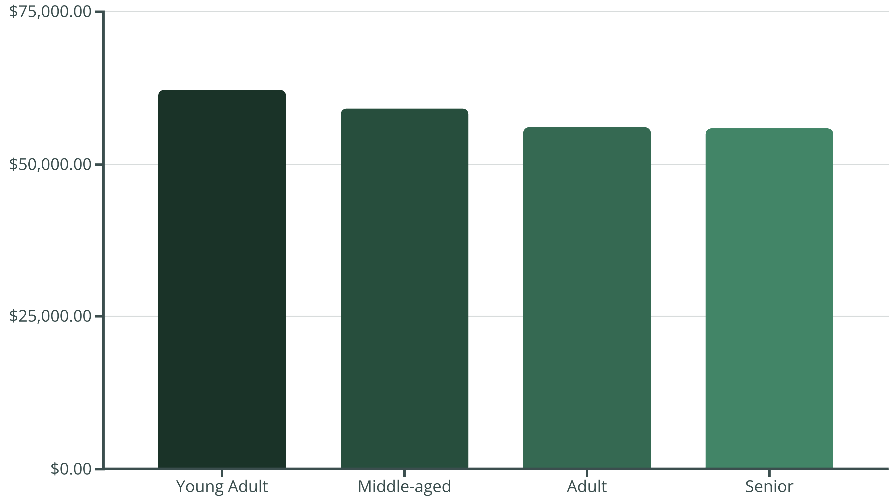
Revenue by Age Group
Young adults generate highest revenue, followed closely by middle-aged customers. Balanced distribution across age groups.

Slide 10





Strategic Recommendations
Boost Subscriptions
Loyalty Programs
Review Discount Policy
Promote exclusive benefits to convert repeat buyers
Reward repeat buyers to increase retention
Balance sales growth with margin control
Targeted Marketing
Product Positioning
Focus on high-revenue age groups and express shipping users
Highlight top-rated items in campaigns

Slide 11
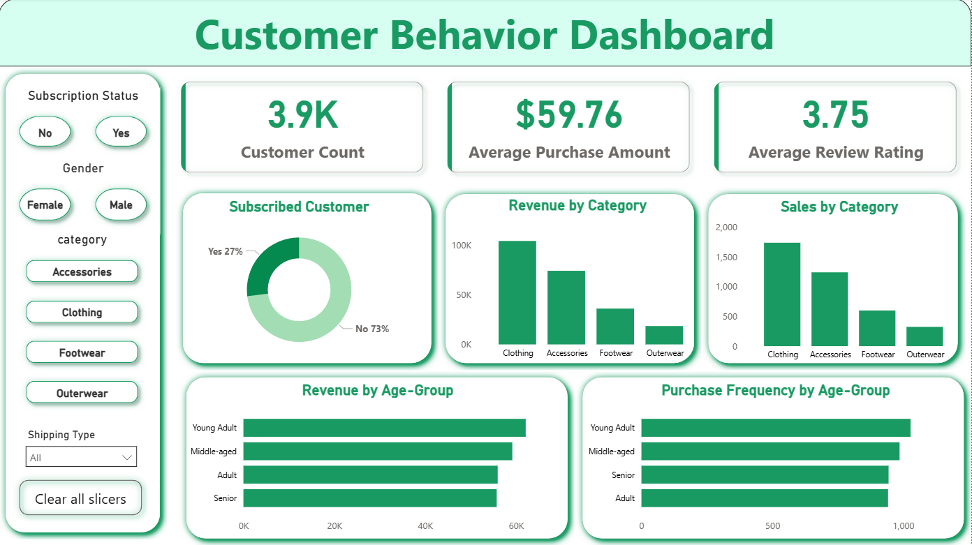
Power BI Dashboard

